Slide 1
Advance Pointer
2017 first semester
Basis and Practice in Programming

Slide 2
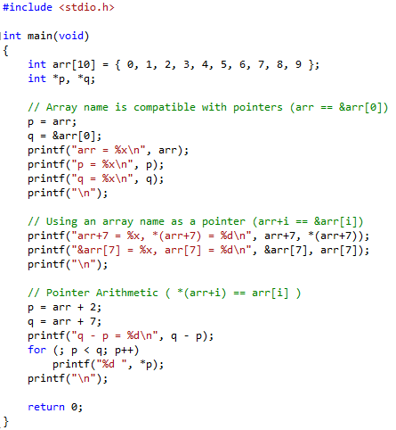
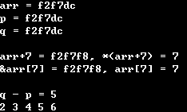
Pointers and Arrays

Slide 3
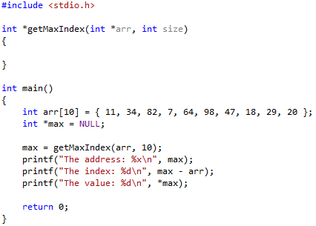

Arrays as Function Parameter

Slide 4
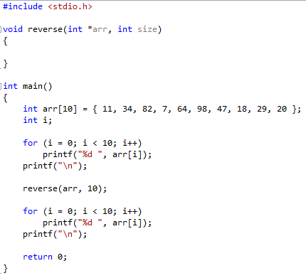
Reverse Function

Slide 5
Practice
For a given sentence, swap the positions of two words separated by the space
The length of the input sentence(array) is fixed to 10
Example) SHEEP GOAT GOAT SHEEP CAT RABBIT RABBIT CAT
C | A | T |  | R | A | B | B | I | T
C | A | T
R | A | B | B | I | T
R | A | B | B | I | T |  | C | A | T

Slide 6
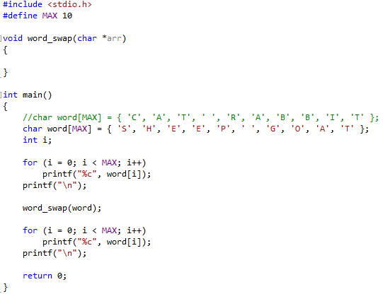
Practice

Slide 7
Appendix
Multi-Dimensional Arrays
int arr[2][5];
arr[0][0] | arr[0][1] | arr[0][2] | arr[0][3] | arr[0][4]
arr[1][0] | arr[1][1] | arr[1][2] | arr[1][3] | arr[1][4]
They are stored linearly in computer memory
arr[0]
arr[1]
[0][0] | [0][1] | [0][2] | [0][3] | [0][4] | [1][0] | [1][1] | [1][2] | [1][3] | [1][4]
arr

Slide 8
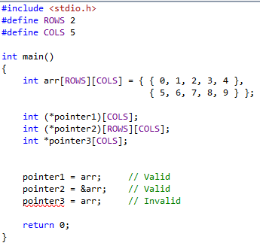
Appendix
Accessing a Element
int a[2][3];
int i, j;
Row Address
a+i
&a[i]
Element Address
a[i]+j
*(a+i)+j
&a[i][j]
*a+sizeof(int)*i+j
Pointer for 2D array

Slide 9
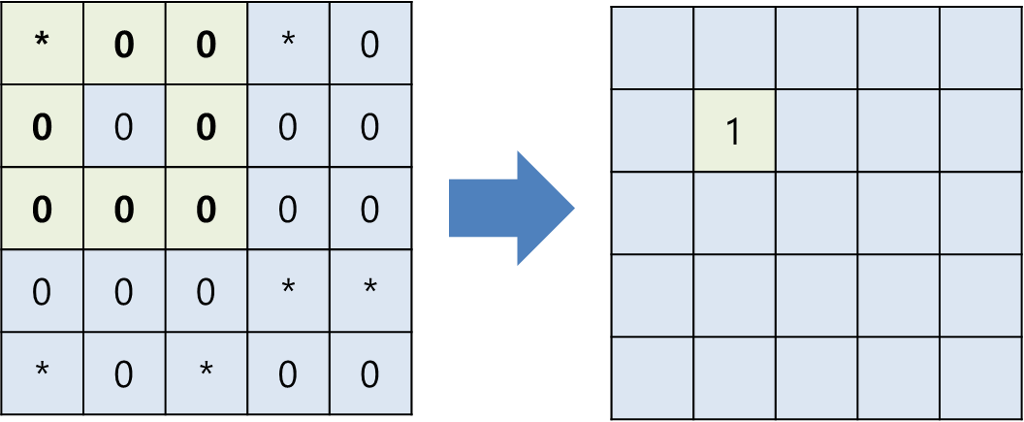
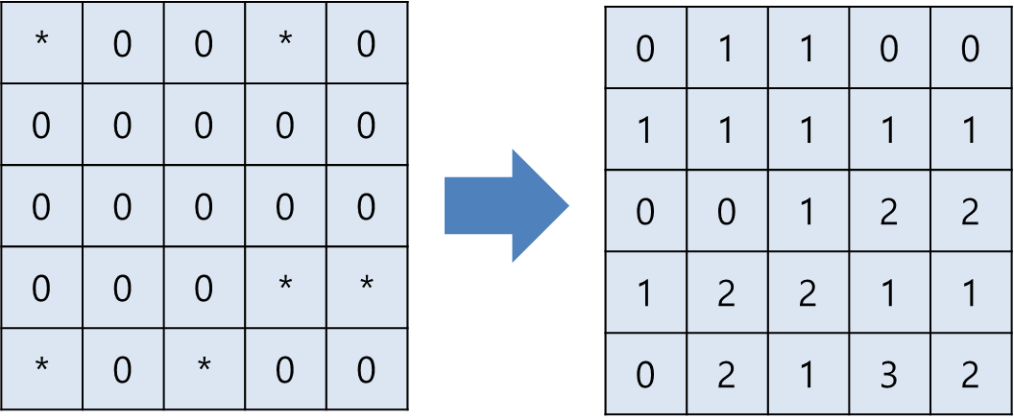
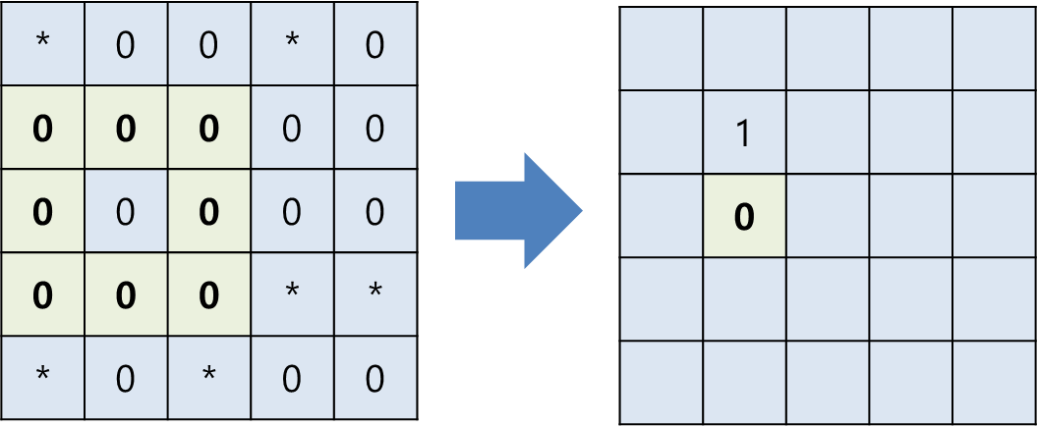
Minesweeper
The input is a 5x5 map with a positions of mines
The output is a 5x5 map with the number of adjacent mines
<Input>
<Output>

